Slide 1

Acting Portfolio Website For Client
For Jackie Alexis Chasten by Mahe N Dewan

Slide 2

Project Statement / Goal
This is a resume and portfolio website for an actor and model, showcasing modeling photos, video examples of previous work, biographical content, and interviews that would sum up the actor entirely. It would have everything an employer would be looking for. The website should be able to sell Jackie (the client).

Slide 3

Your motivation, drive, and/or purpose
The process of creating this website will allow me to familiarize myself with website design on a base level as well as understanding HTML, Jquery, and CSS as tools in design. It also allows me to showcase my already published work with a very prolific collaborator of mine. The client also asked for this.

Slide 4

Target Audience
The target audience would be employers and casting agents in need of Jackie’s specific talents; I have specifically modeled it towards possible user interviews of casting agents I’ve met. They want to see pictures and proof of Jackie's work and that’s usually it.

Slide 5

Competitive Analysis
A main competitor would be imdb.com for professionals which allow actors to create their own page in the database. IMDBpro includes information for agencies, both for casting and for modeling, with very unbiased language that tries to put every actor on the same, level playing field. IMDBpro, however, doesn’t include examples of the people’s work other than titles and credits. For my website, everything you could possibly want to know when hiring Jackie will be native to the site so users don’t have to do additional research. I would, nevertheless, like to borrow the “Contact This Person’s Agent” feature in IMDBpro except it would be a form on the website that would link to my email.

Slide 6

Content Inventory
The site will include minimalistic UI elements like arrows and dots but the bulk will be actual documentation: videos and photos and text blocks.

Slide 7

Technical Requirements/Functionality
HTML5 luckily has video playing features so I won’t have to link out to Vimeo. I have just finished my carosel functionality. Now I have to work on a gallery function.

Slide 8

Creative Brief
The feel should be sleek and flat as to not drive attention away from any of Jackie’s work or even just her face. It should also be easy to understand. The color palette is as follows:

Slide 9
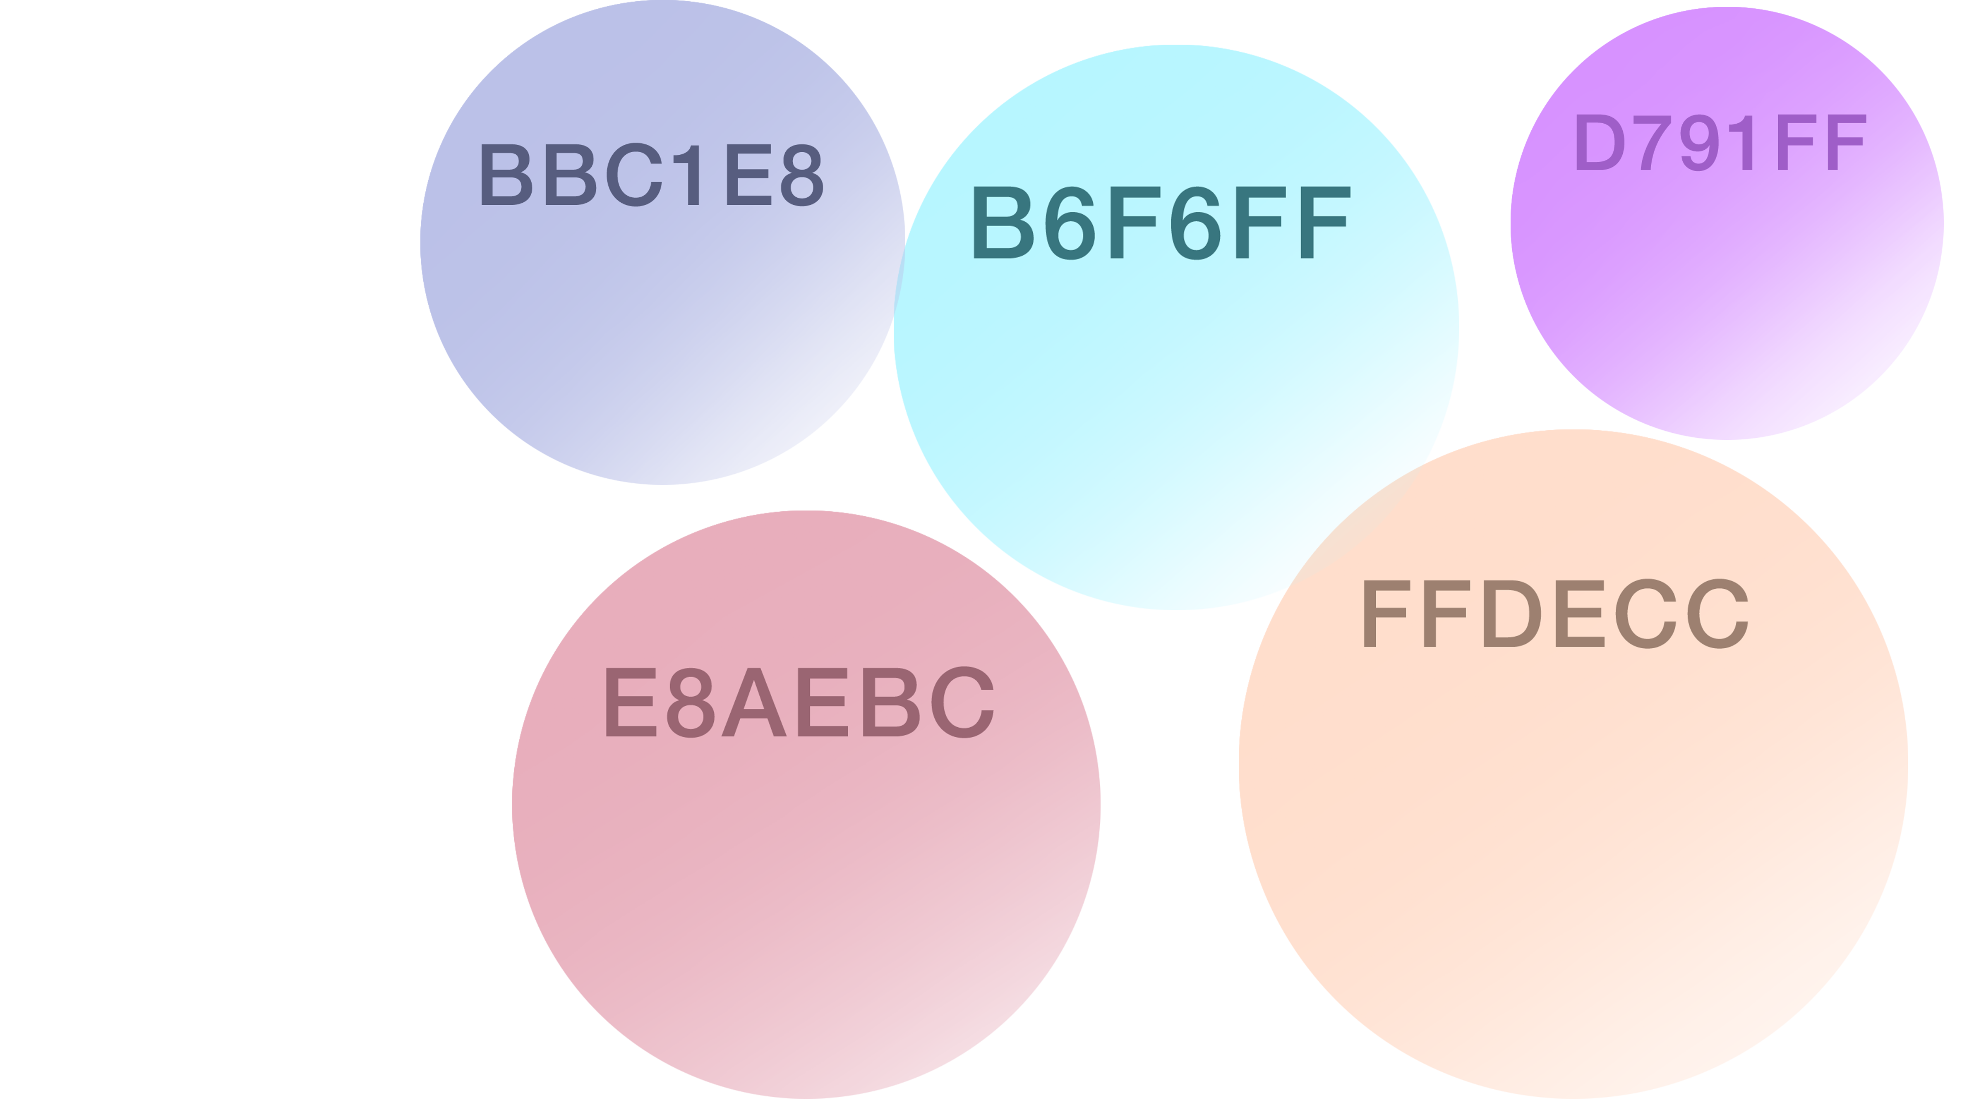

Slide 10

What To Expect On Final Due Date
Gallery pages linked from main page.
Video content.
Contact form/page.

